Slide 1
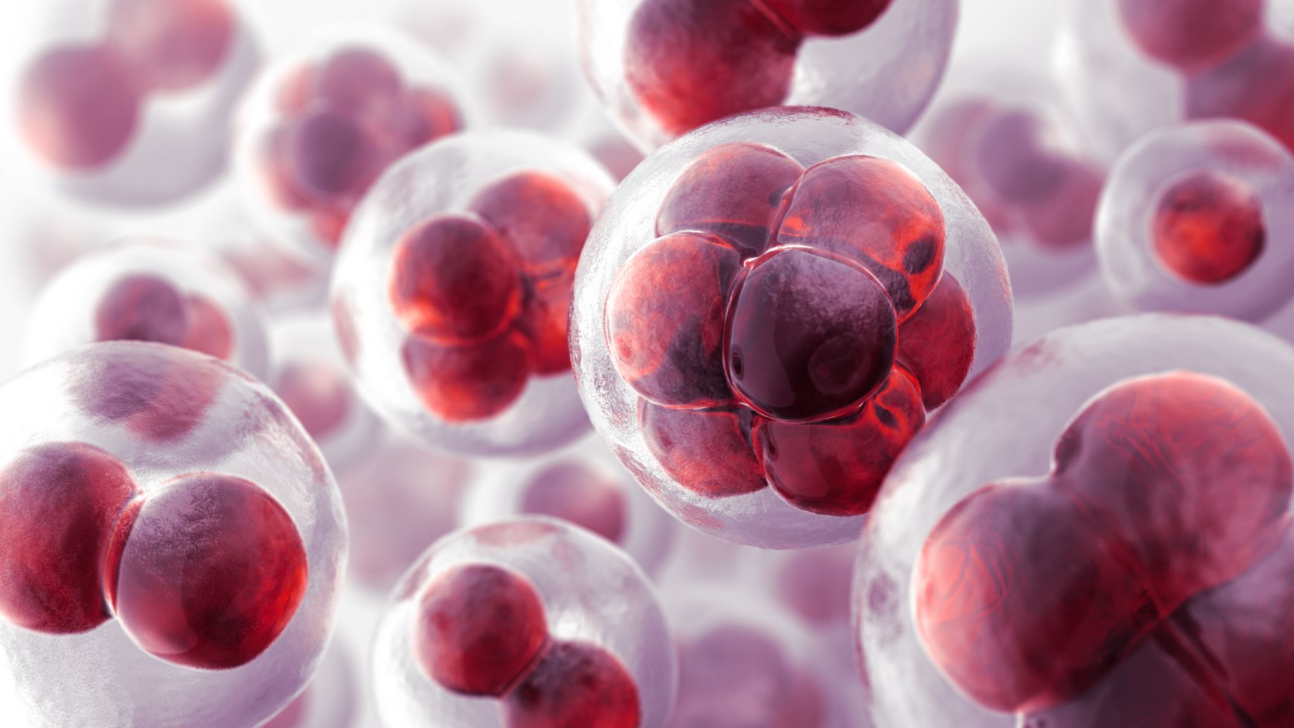
Image Classification on Medical Dataset - Melanoma Detection
Name: Abhishek Dabas
Team 9
NUID: 001302629

Slide 2
INTRODUCTION
Name: Abhishek Dabas
Fall 19 Student
Course – Information Systems
VP of Research and Development at AI Skunkworks
Interest: Machine Learning and AI

Slide 3
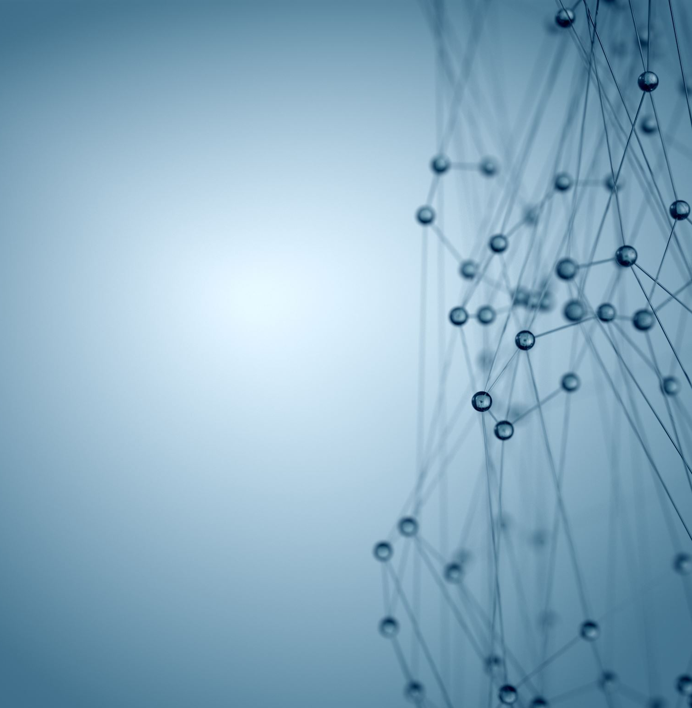
Background

Slide 4
Melanoma
Melanoma is a skin cancer that arises from a skin cell called a melanocyte, which makes a the pigment (melanin) that gives your skin its color.
Melanoma can appear in different ways, most commonly as a new spot on the skin or as an already existing mole that changes in color, size, or shape.
While considered the most dangerous type of skin cancer because of its ability to rapidly spread throughout the body, melanoma is generally very treatable if found early
The Society for Imaging Informatics in Medicine (SIIM) is the leading healthcare professional organization for those interested in the current and future use of informatics in medical imaging. The society's mission is to advance medical imaging informatics across the enterprise through education, research, and innovation in a multi-disciplinary community.

Slide 5
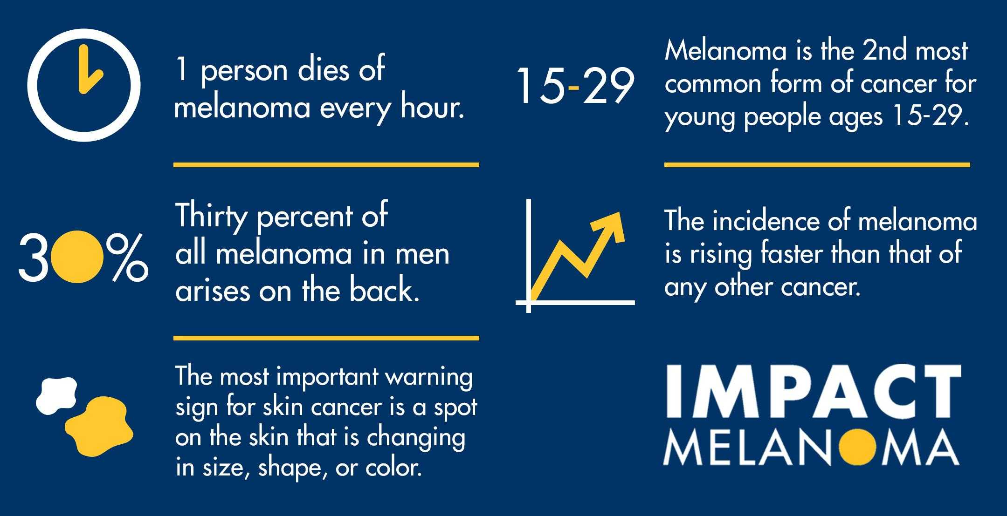

Slide 6

Goal
The objective here is to identify melanoma in images of skin lesions with Computer Vision.
Image Classification. We need to create a CNN Model which should predict the probability whether the lesion in the image is malignant or benign.
We will use PyTorch with multiple GPU’s and different hyperparameters for training the model and test which ones work best for our particular use-case. Data Size 23.9GB.

Slide 7
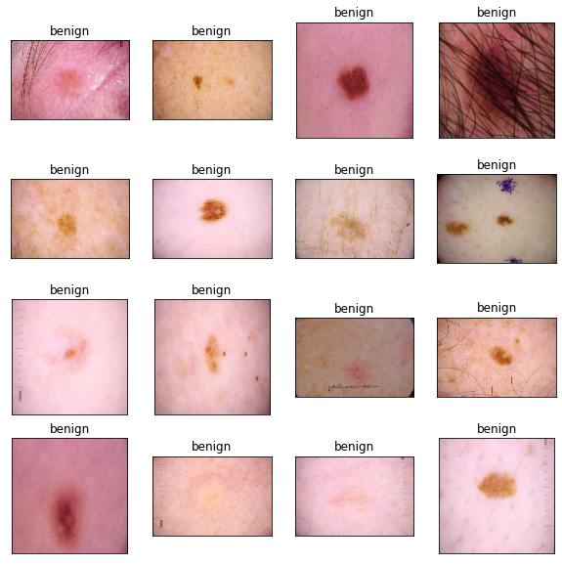
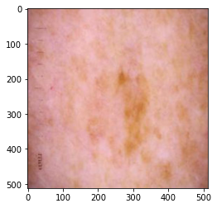
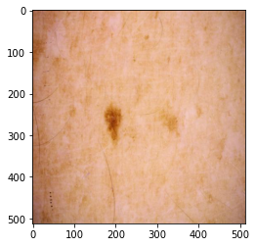
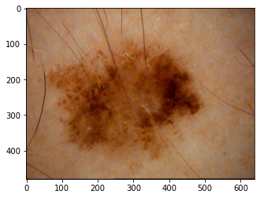
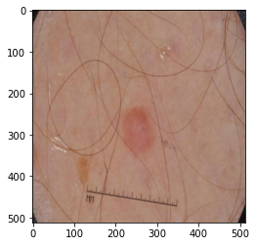
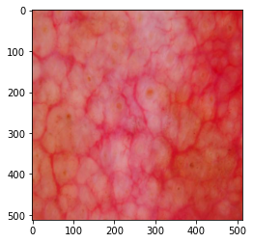
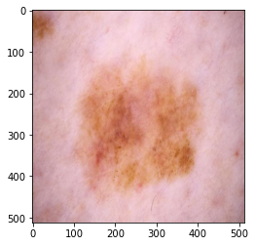
Image Visualizations
Benign
Malignant

Slide 8
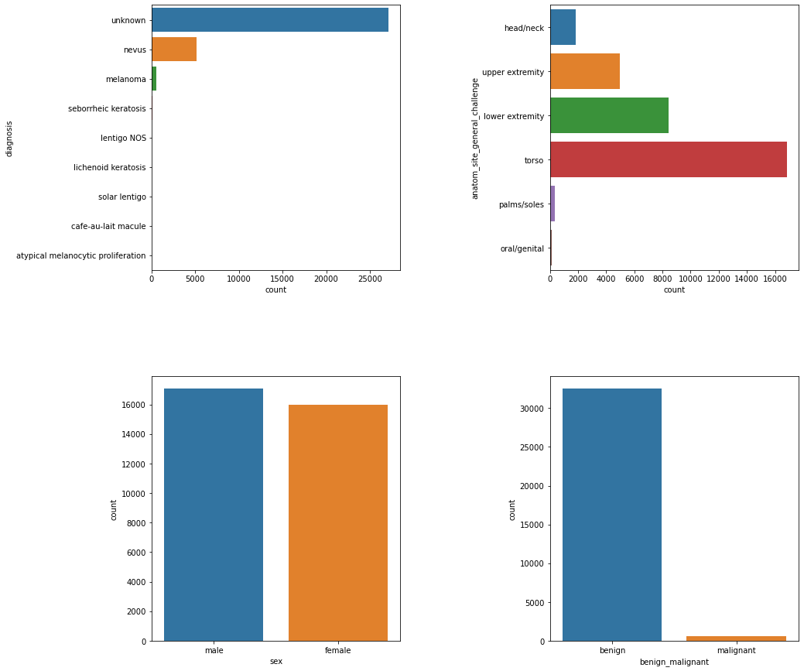
Statistical Analysis of the Melanoma- Data

Slide 9
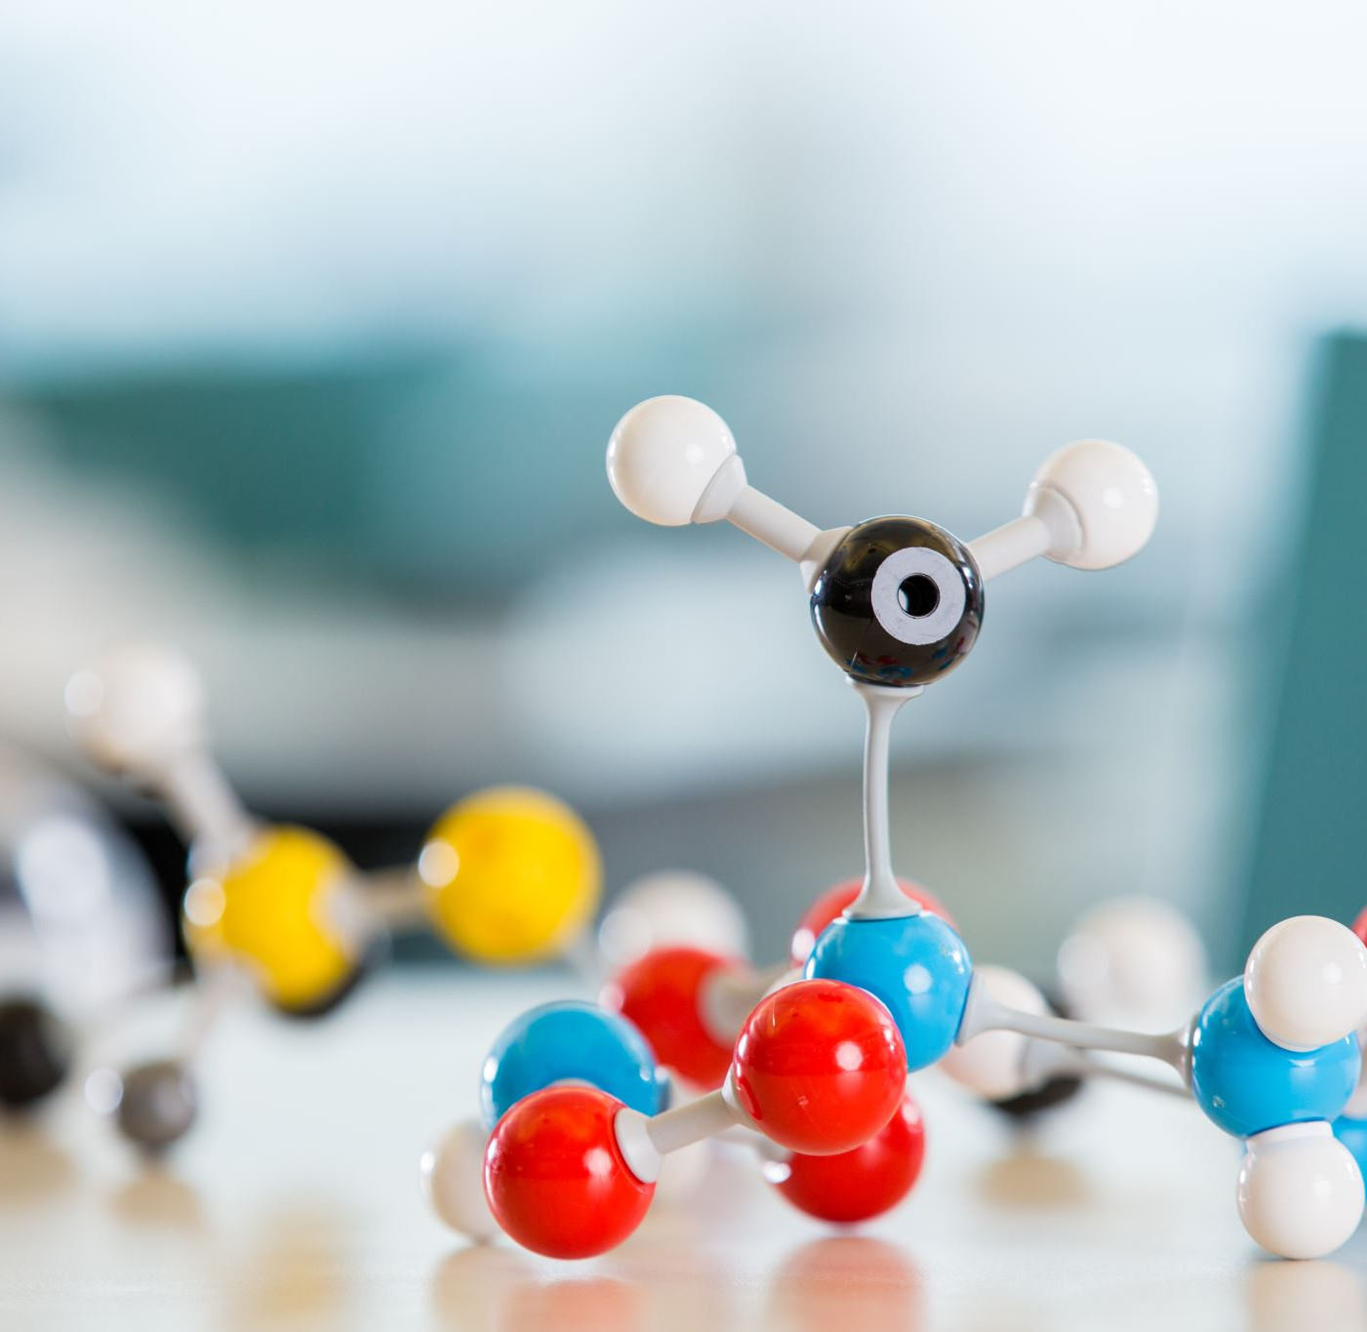
Model
ResNet152 from ResNet Family

Slide 10
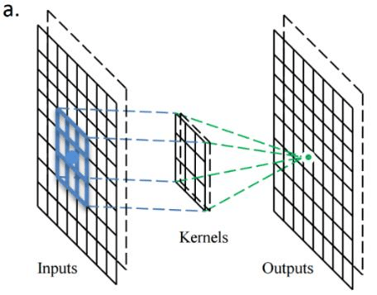
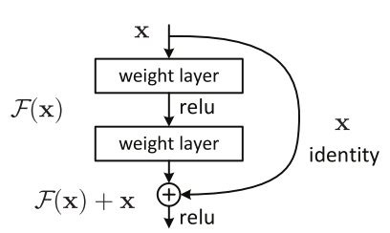
ResNet152
One of the most groundbreaking models in Computer Vision
Deep networks are hard to train because of the vanishing gradient problem
ResNets have shortcut connections to skip one or more layers. This skip connection handles the accuracy degradation.

Slide 11
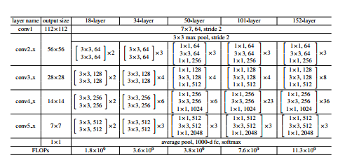
Architecture
Performs the initial convolution and max pooling using 7*7, 3*3 kernel sizes respectively
Stage 1 of the network starts here and there is 3 Residual blocks containing 3 layers each. The size of kernels used to perform the convolution operation in all 3 layers of the block of stage 1 are 64, 64 and 256 respectively
The dashed connection arrow refers to the convolutional operation, performed with a stride of 2, which reduced the size of the input by half.
In total, we extract 2048- dimensional features from the last fully- pooling layer (Conv5x layer)
The network has an average Pooling layer followed by fully connected layer, which then outputs the number of classes we want to classify.

Slide 12
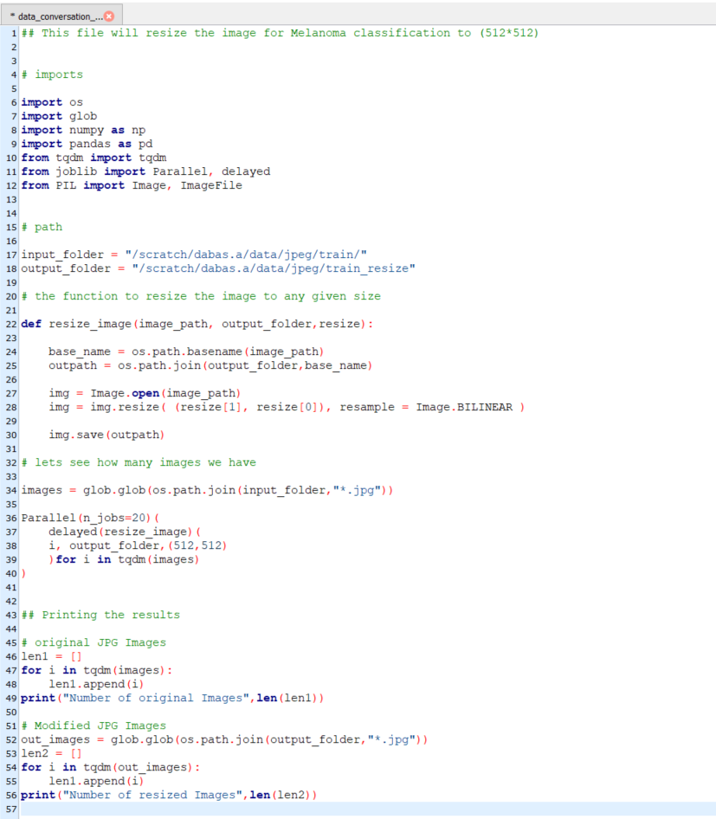
Resize the Image
The Resnet network can take the input image having height, width as multiples of 32 and 3 as channel width.
“Joblib” provides a simple helper class to write parallel for loops using multiprocessing. Using this libarary the images of 23.9GB are reshaped in approx. 20min. Which otherwise takes around ~2 Hours.
Original Image shape: 4000*6000*3
Resized Image size : 512*512*3
Code:

Slide 13
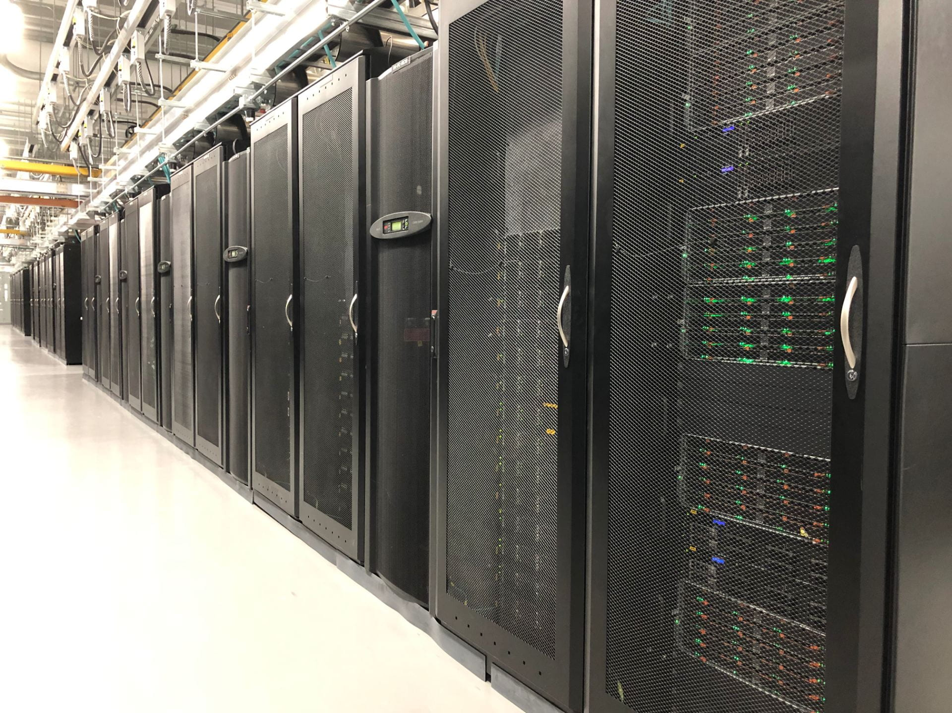
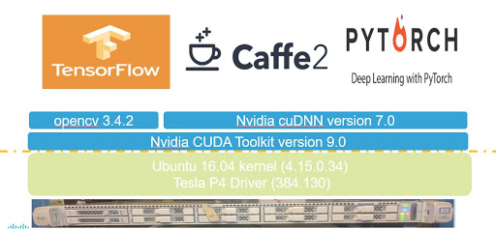
System:
Cluster Name: Discovery High Performance Computing Cluster
Reservation Name: CSYE7105-gpu
GPU:
GPU Model: Tesla V100-SXM2
Tesla V100 is the flagship product of Tesla data center computing platform for deep learning, HPC, and graphics.
Memory per GPU: 32510Mib
Number of GPU’s used: 1,2,3,4

Slide 14
Commands to Access Cluster
Access the reservation
srun -p reservation --reservation=csye7105-gpu --gres=gpu:1 --mem=100G --pty /bin/bash
Activate the anaconda environment
conda activate pytorch
GPU Details
nvidia-smi
Run the model
python model.py

Slide 15
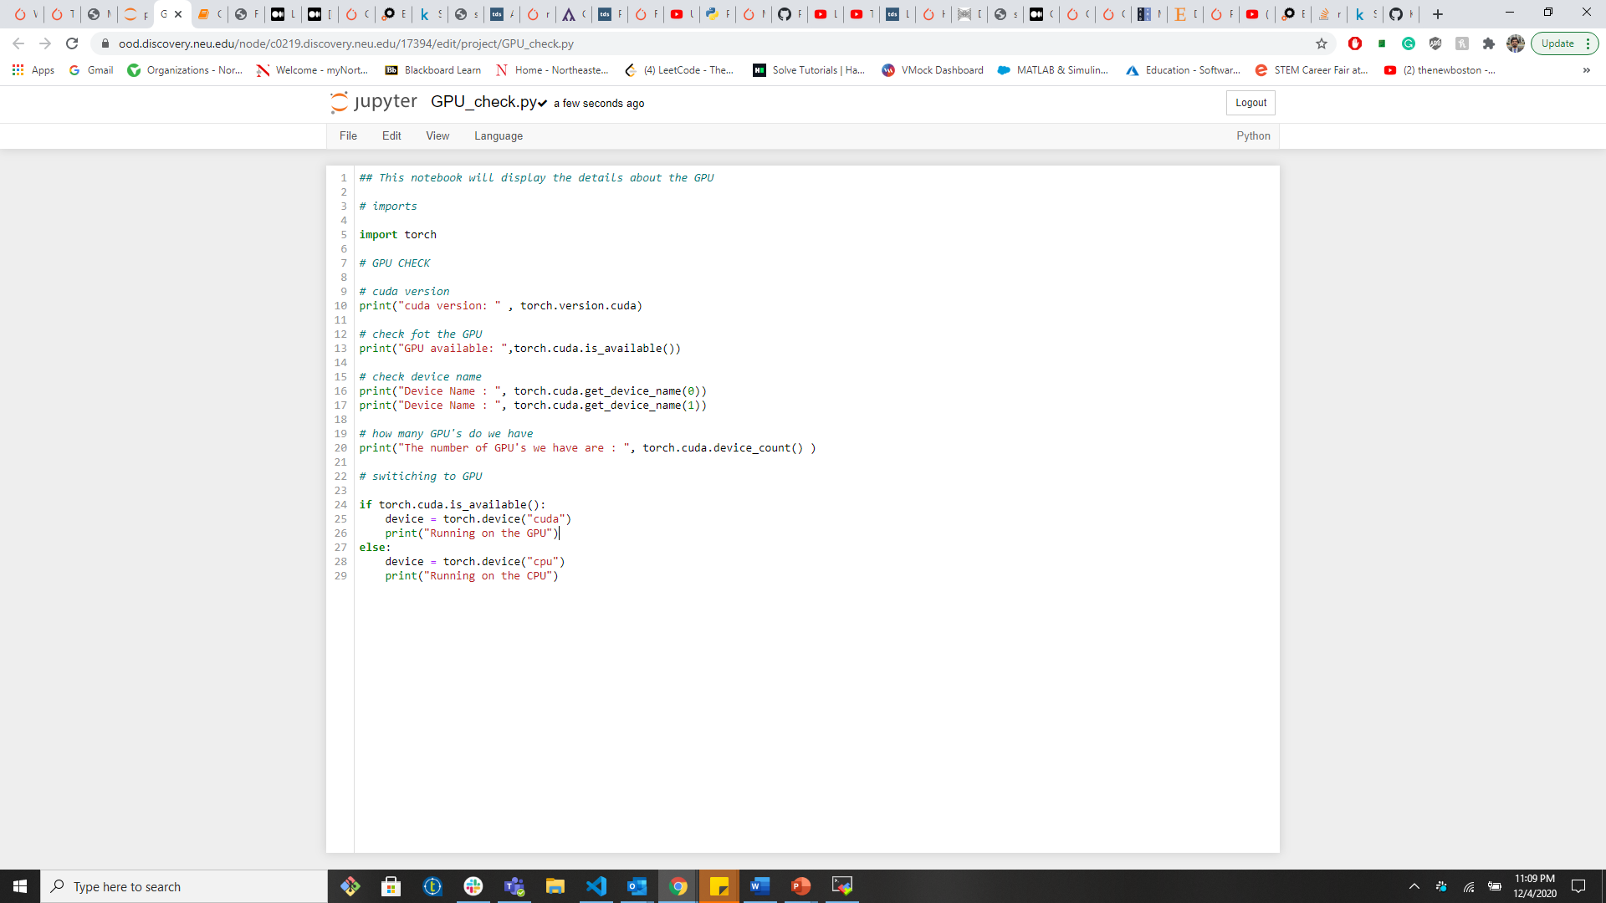
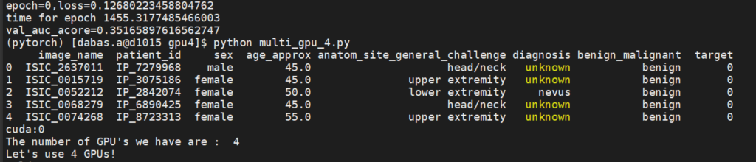
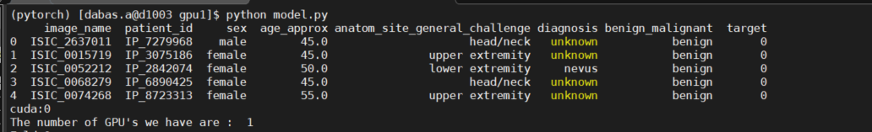
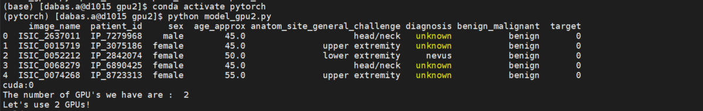
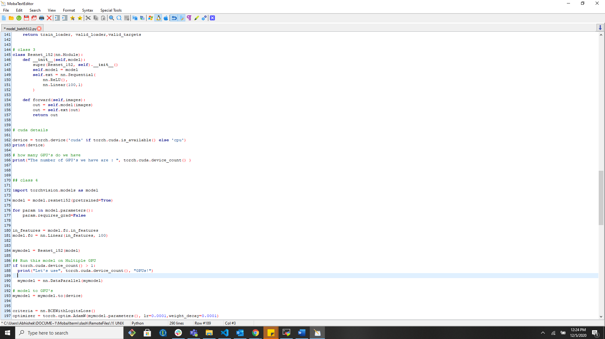
Checking the number of GPU’s

Slide 16
Workflow
Imports
Image Resize
Data Augmentation
Building the ResNet Model
Training and evaluate the Model
Saving model and Plotting the results

Slide 17

Experiments Experiment 1: Multiple GPU’s (1,2,3,4) & Data parallelism Experiment 2: Multiple EPOCHS (10,20) Experiment 3: Multiple Batch SIZE (128,256,512) Experiment 4: GPU vs CPU

Slide 18
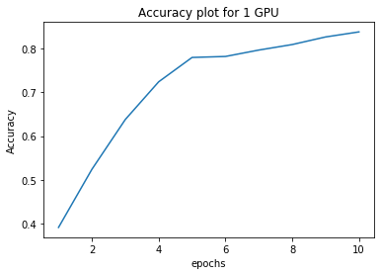
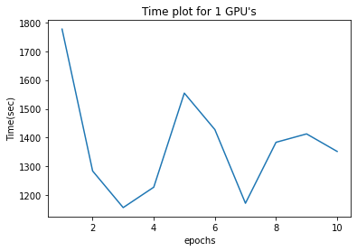
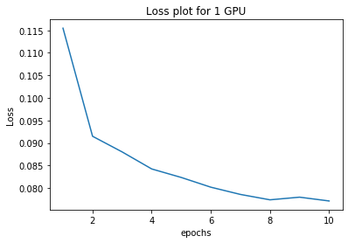
With GPU’s #1 and Data Parallelism: No EPOCH 10, BATCH SIZE 256

Slide 19
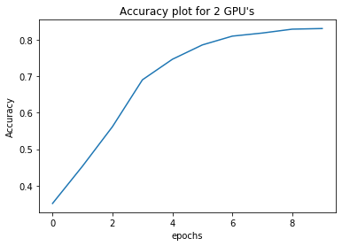
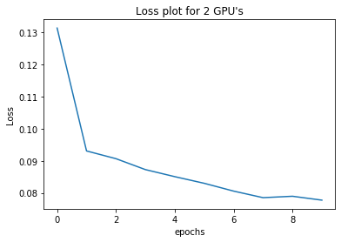
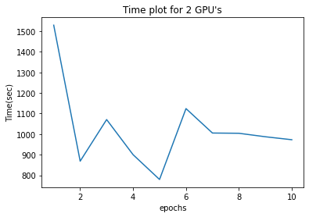
With GPU’s #2 and Data Parallelism: Yes EPOCH 10, BATCH SIZE 256

Slide 20
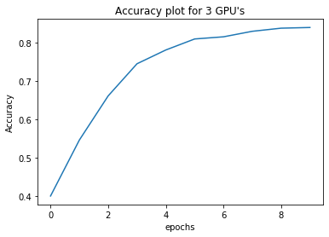
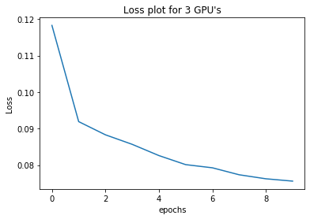
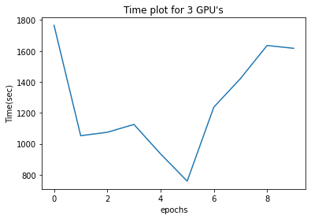
With GPU’s #3 and Data Parallelism: Yes EPOCH 10, BATCH SIZE 256

Slide 21
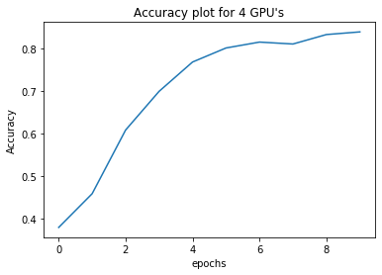
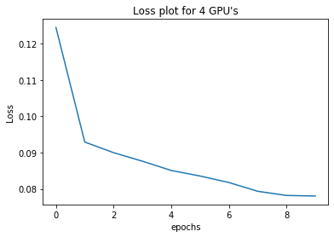
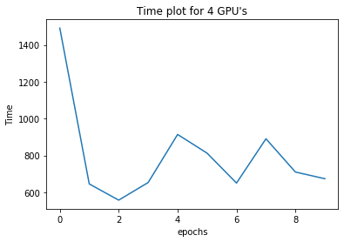
With GPU’s #4 and Data Parallelism: Yes EPOCH 10, BATCH SIZE 256

Slide 22
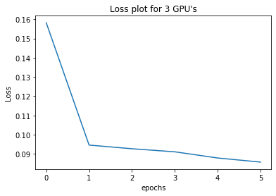
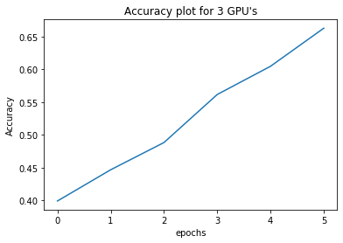
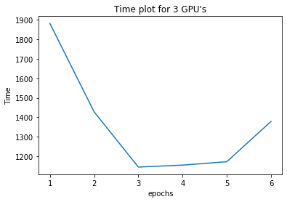
With GPU #3 and Model Parallelism: Yes EPOCH = 5, Batch Size = 512

Slide 23
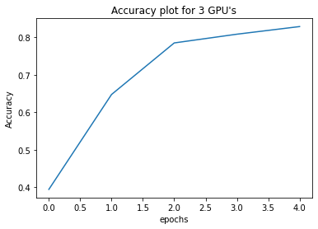
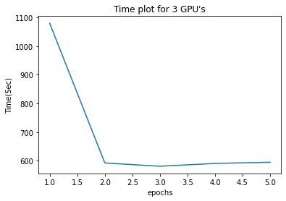
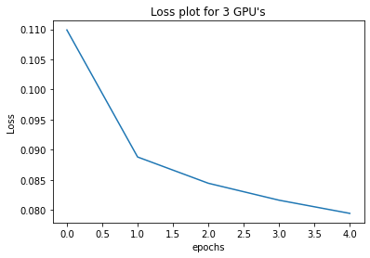
With GPU #3 and Model Parallelism: Yes EPOCH 5, Batch size 128

Slide 24
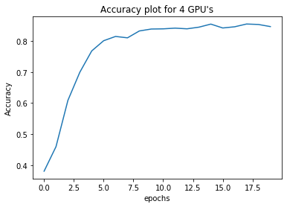
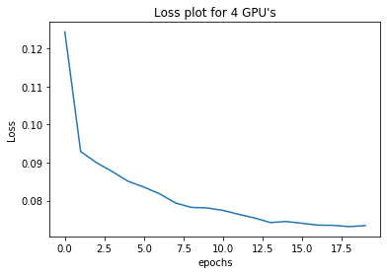
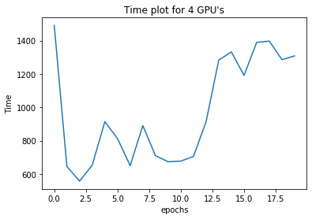
With GPU #4 and Model Parallelism: Yes EPOCH = 20, Batch Size = 256

Slide 25

Analysis

Slide 26
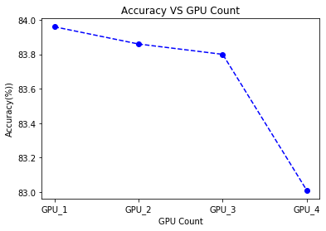
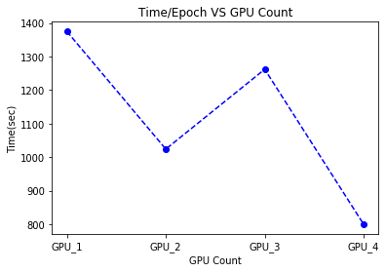
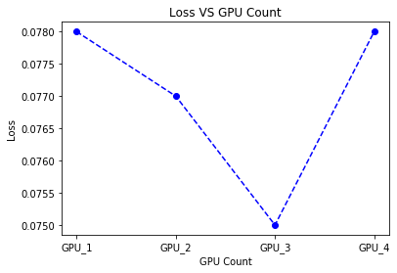
GPU Count vs Performance Epoch 10, Batch size - 256

Slide 27
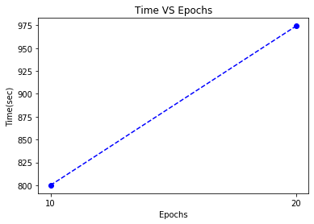
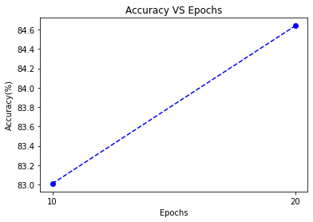
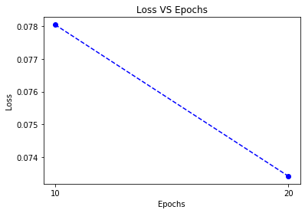
EPOCHS vs Performance GPU’S – 4, Batch size - 256

Slide 28



Batch size vs Performance EPOCH 5, Batch size 128,256,512

Slide 29



CPU vs GPU Performance: EPOCH – 2, Batch Size - 256

Slide 30

Results

Slide 31
Increasing the number of GPU’S decreases the computation time but doesn’t always help in the performance. The is a tradeoff between the number of GPU’s and the performance we can achieve through it.
Increasing the number of EPOCH’s doesn’t change the performance drastically. The accuracy increases till a point after which there is not much increase in the performance. Hence the accuracy and loss doesn’t differ much after a certain number of EPOCHS. There is a tradeoff between the number of EPOCHS and the number of GPU’s.
Increasing the batch size doesn’t increase the performance hence there is a tradeoff between the number of batch sizes and the best performance. Lower batch size works best for us.
There is a drastic increase in the performance when using a GPU as compared to a CPU. There is a huge difference between the execution time of the two. A GPU can render images very quickly, hence it works better for complex computational problems and works great with CNN’s.
Looking at all the results we can say that the model works best with 3 GPU’s and Data Parallelism for the given computations in the problem, for EPOCH 10 and Batch Size 128.

Slide 32

References:
https://cv-tricks.com/keras/understand-implement-resnets/
https://www.researchgate.net/figure/The-basic-architecture-of-Resnet152_fig2_324961229
Resnet 50 : http://ethereon.github.io/netscope/#/gist/db945b393d40bfa26006
Deep Residual Learning for Image Recognition: https://arxiv.org/pdf/1512.03385.pdf
Tesla Volta V100 : http://images.nvidia.com/content/technologies/volta/pdf/tesla-volta-v100-datasheet-letter-fnl-web.pdf
Data Parallelism : https://www.sciencedirect.com/topics/computer-science/data-parallelism#:~:text=Data%20parallelism%20means%20that%20each,deep%20net%20structure%20and%20parameters.

Slide 33
Thankyou!! - Abhishek Dabas

